Slide 1

Visión por Computador
Domingo Mery
Departamento de Ciencia de la Computación
Escuela de Ingeniería
Universidad Católica de Chile
CLIP
[ Capítulo 3 ]

Slide 2

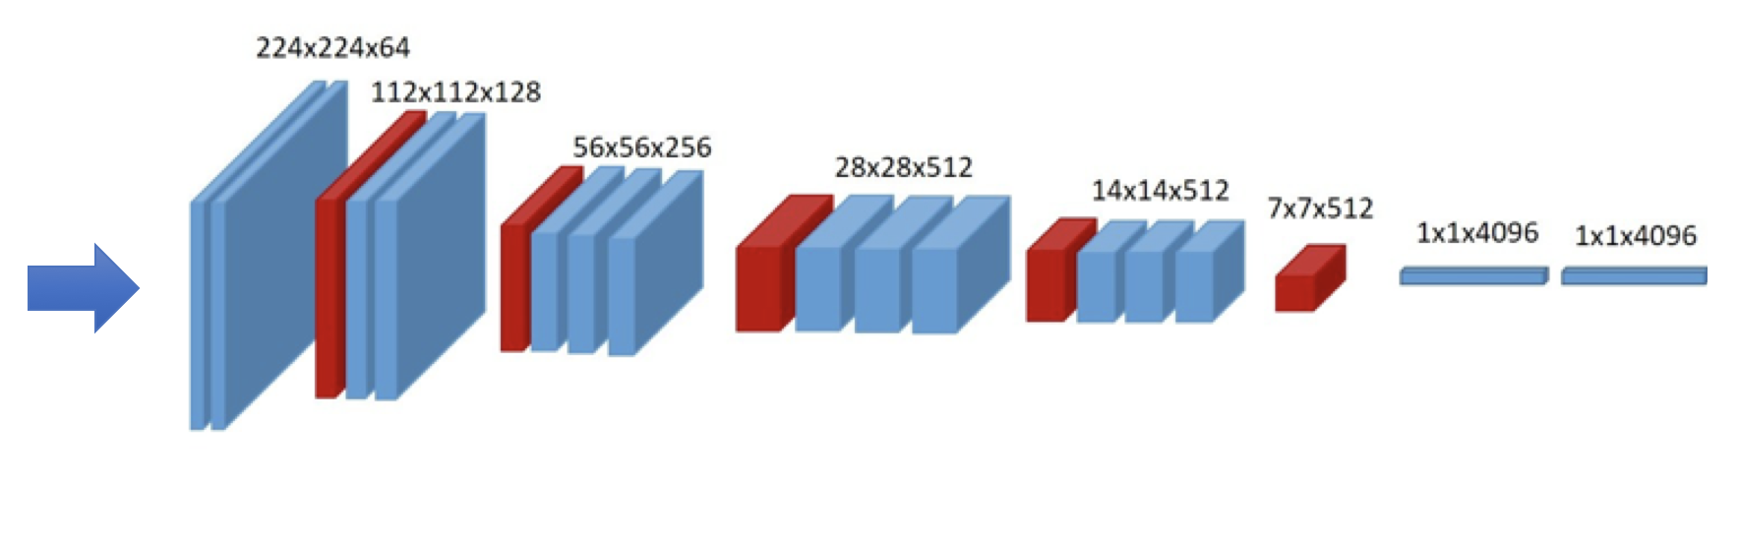

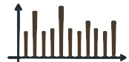

Embeddings
EMBEDDINGS: vectors of n elements that describe the input. Typically, they have a norm equal to 1, and n=512.
INPUT 1
EMBEDDING 1
sc
SCORE: It measures how similar the embeddings are
HIGH → similar
LOW → different
INPUT 2
EMBEDDING 2

Slide 3
Embeddings
sc

Slide 4
Embeddings
HOW SIMILAR ARE TWO VECTORS?
DON'T FORGET: in our case the vectors have 512 elements and have a norm equal to 1
DOT PRODUCT
SCORE
If the vectors are very similar, the angle between them is small and the SCORE is close to 1.

Slide 5
Embeddings
HOW SIMILAR ARE TWO VECTORS?
DON'T FORGET: in our case the vectors have 512 elements and have a norm equal to 1
DOT PRODUCT
SCORE
If the vectors are very similar, the angle between them is small and the SCORE is close to 1.
If the vectors are very different, the angle between them is large and the SCORE decreases significantly.

Slide 6
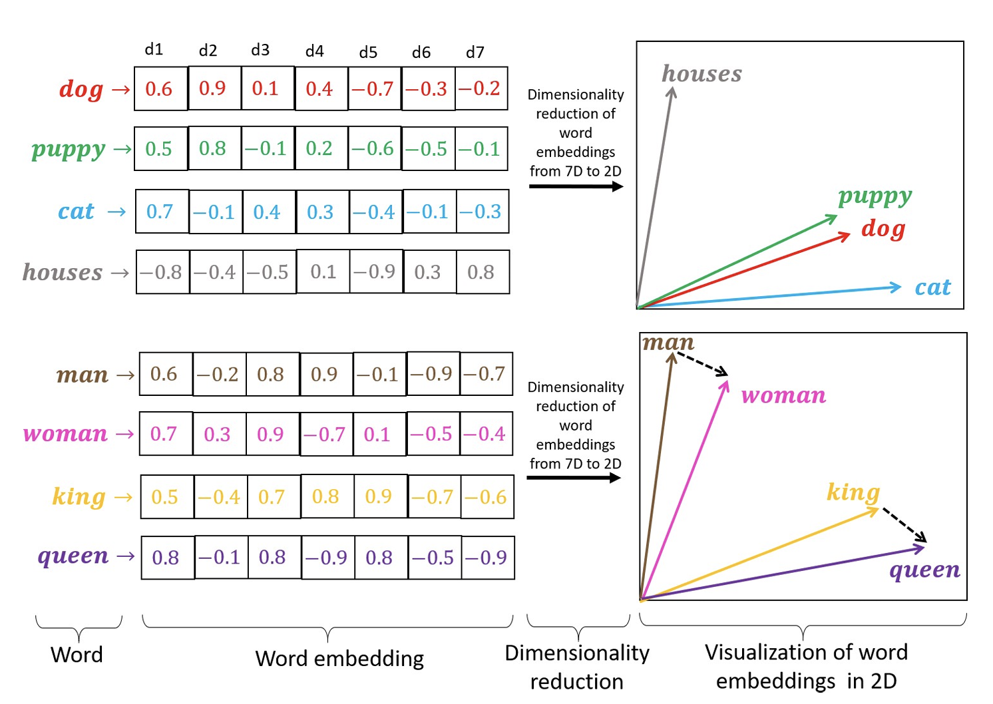


Embeddings in NLP
Token
Token embedding
token
Adapted from: Rozado, D. (2020). Wide range screening of algorithmic bias in word embedding models using large sentiment lexicons reveals underreported bias types. PloS one, 15(4), e0231189.

Slide 7
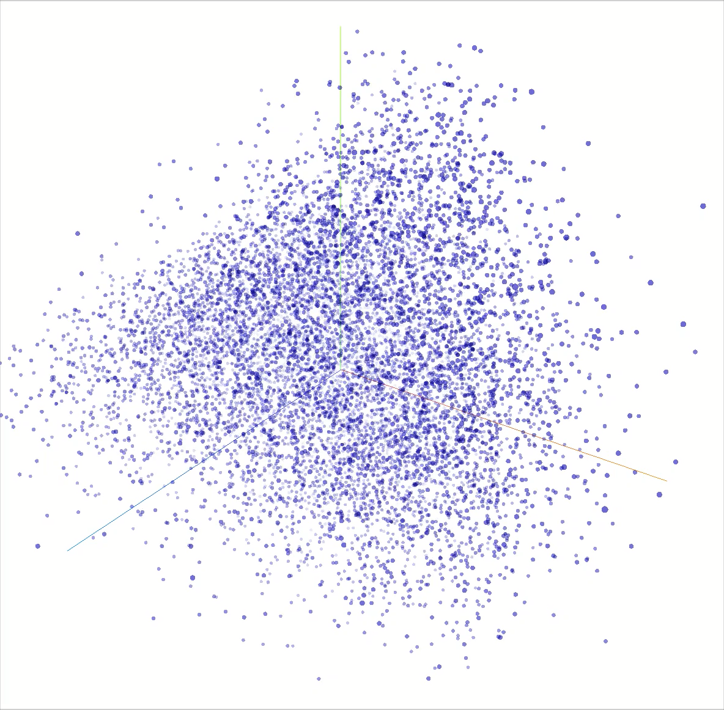
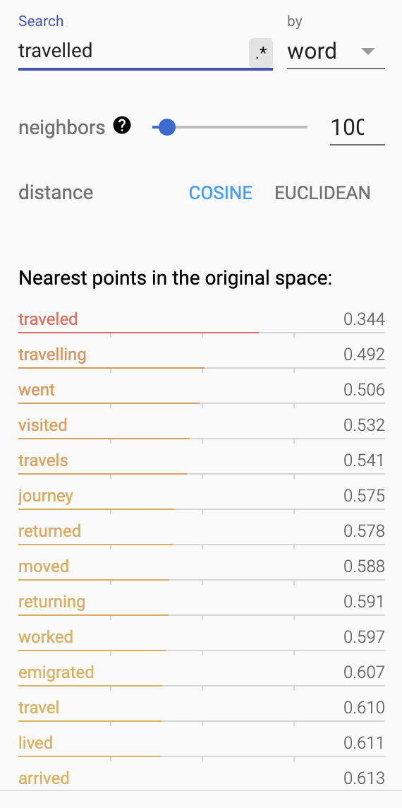
Embedding Projector
https://projector.tensorflow.org/

Slide 8

Key Idea of CLIP
Image
Encoder
EMBEDDING 1
VERY
SIMILAR
Two people relax on a bench under a tree, enjoying a serene ocean view.
Text
Encoder
EMBEDDING 2
→ HIGH

Slide 9
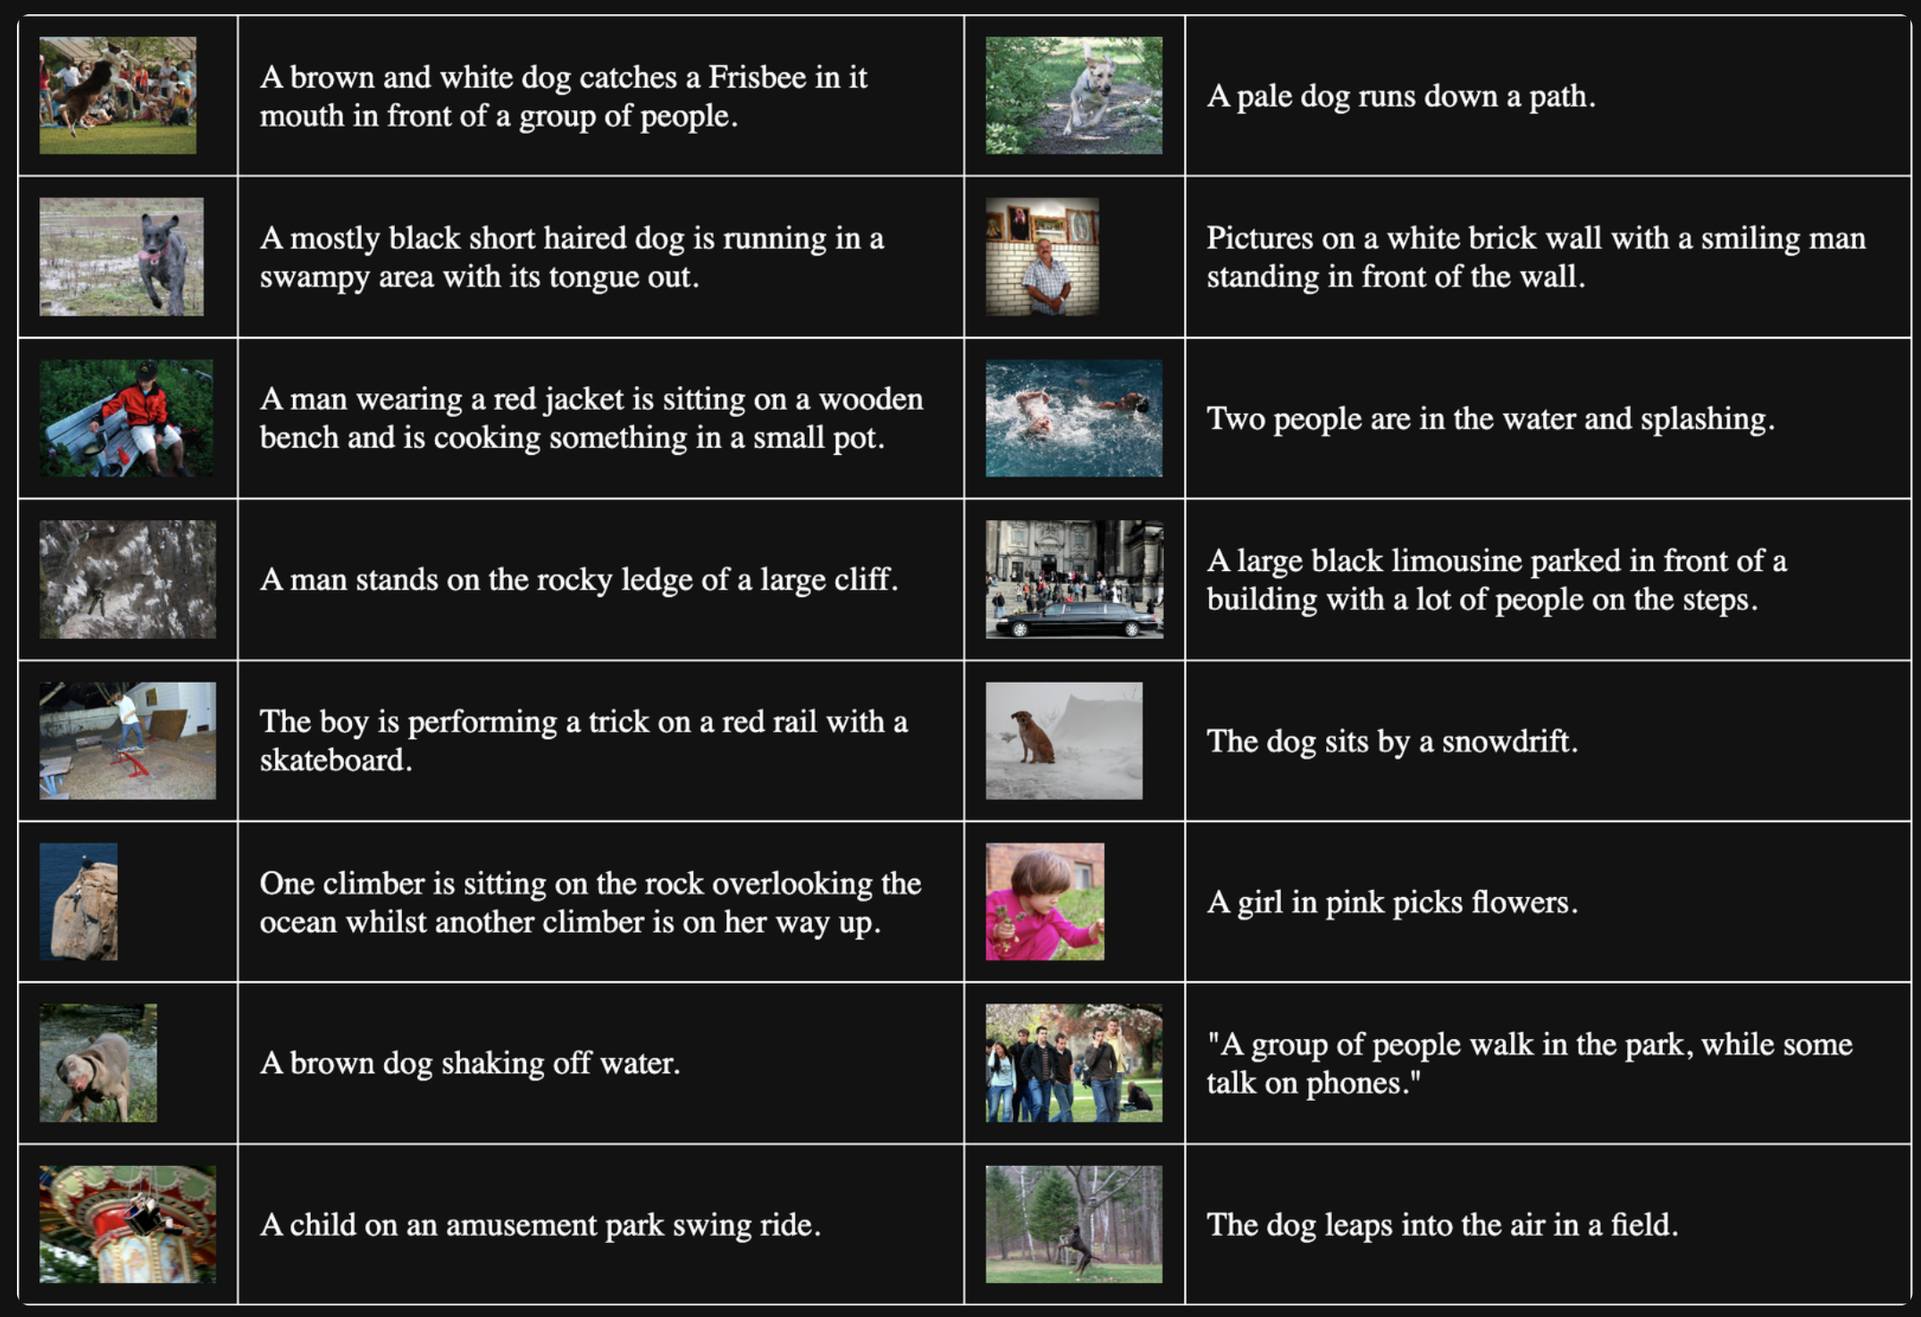
Data Collection: (Image , Text) pairs

Slide 10
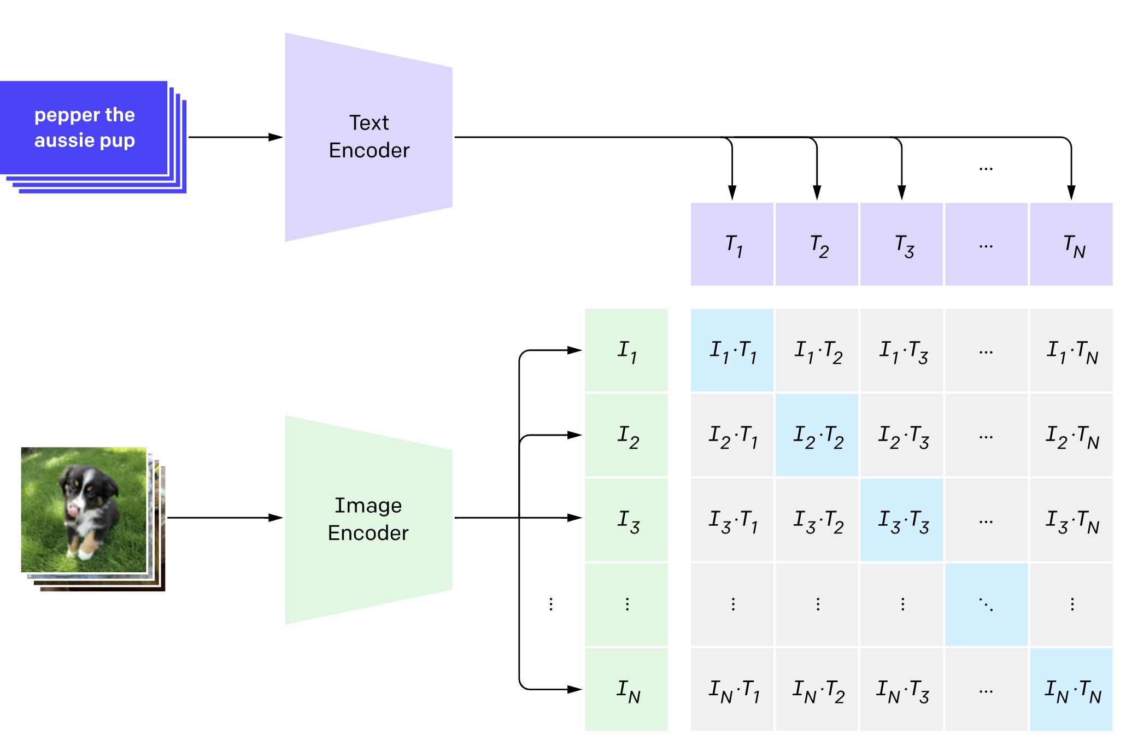
Contrastive Pre-Training

Slide 11
Contrastive Pre-Training
Maximize the diagonal

Slide 12
Contrastive Pre-Training
Contrastive loss: minimizes distance between correct pairs, maximizes for incorrect pairs.
Maximize the diagonal,
and minimize the non-diagonal

Slide 13
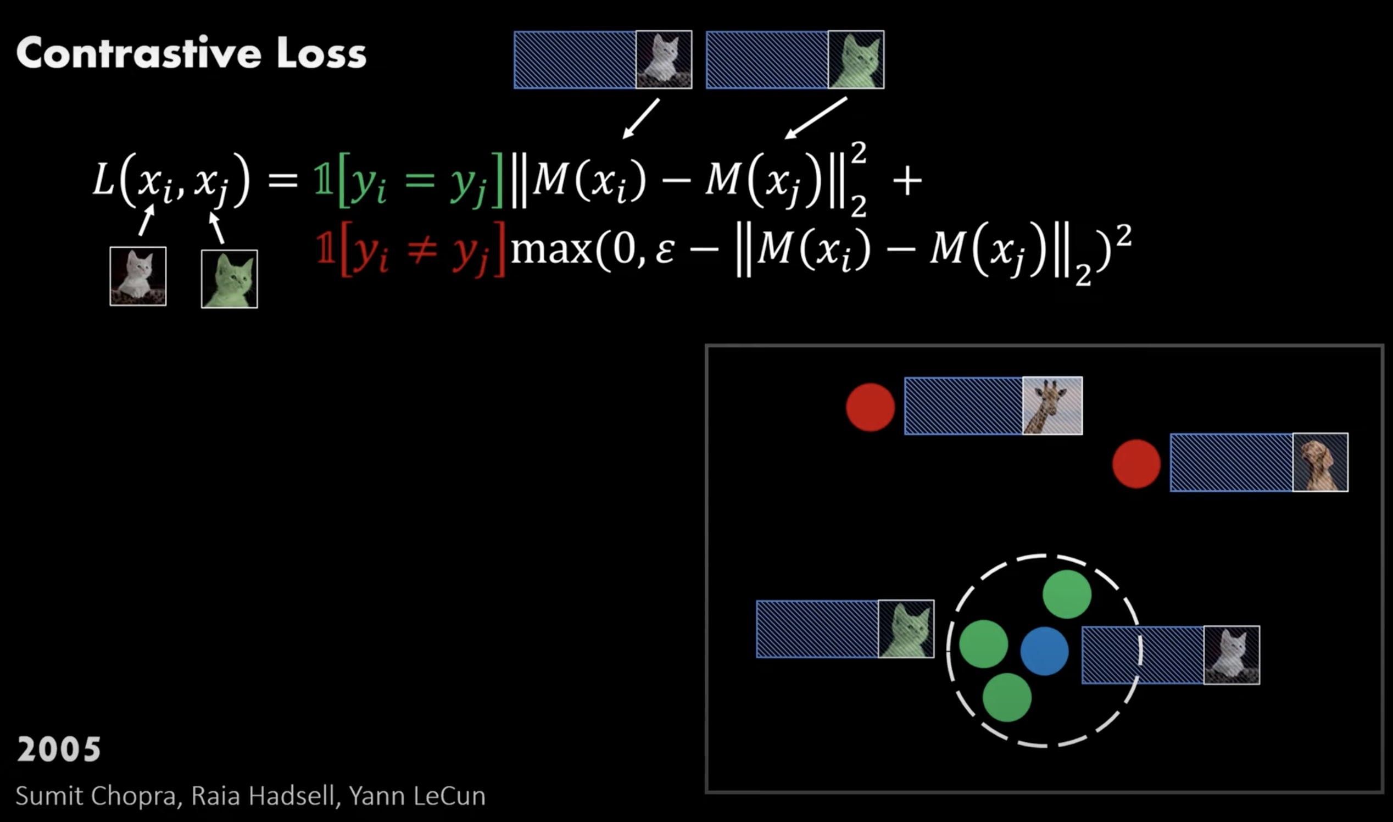
Max Margin Loss
https://youtu.be/u-X_nZRsn5M?si=hVAEmak-y7D7yqms

Slide 14
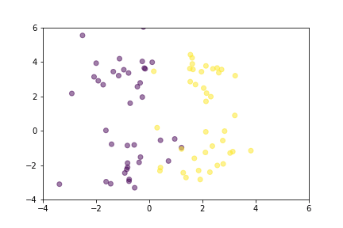
Contrastive Loss

Slide 15
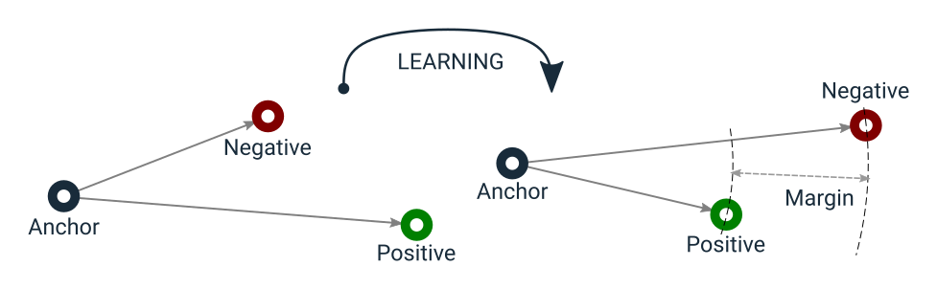
Triplet Loss

Slide 16
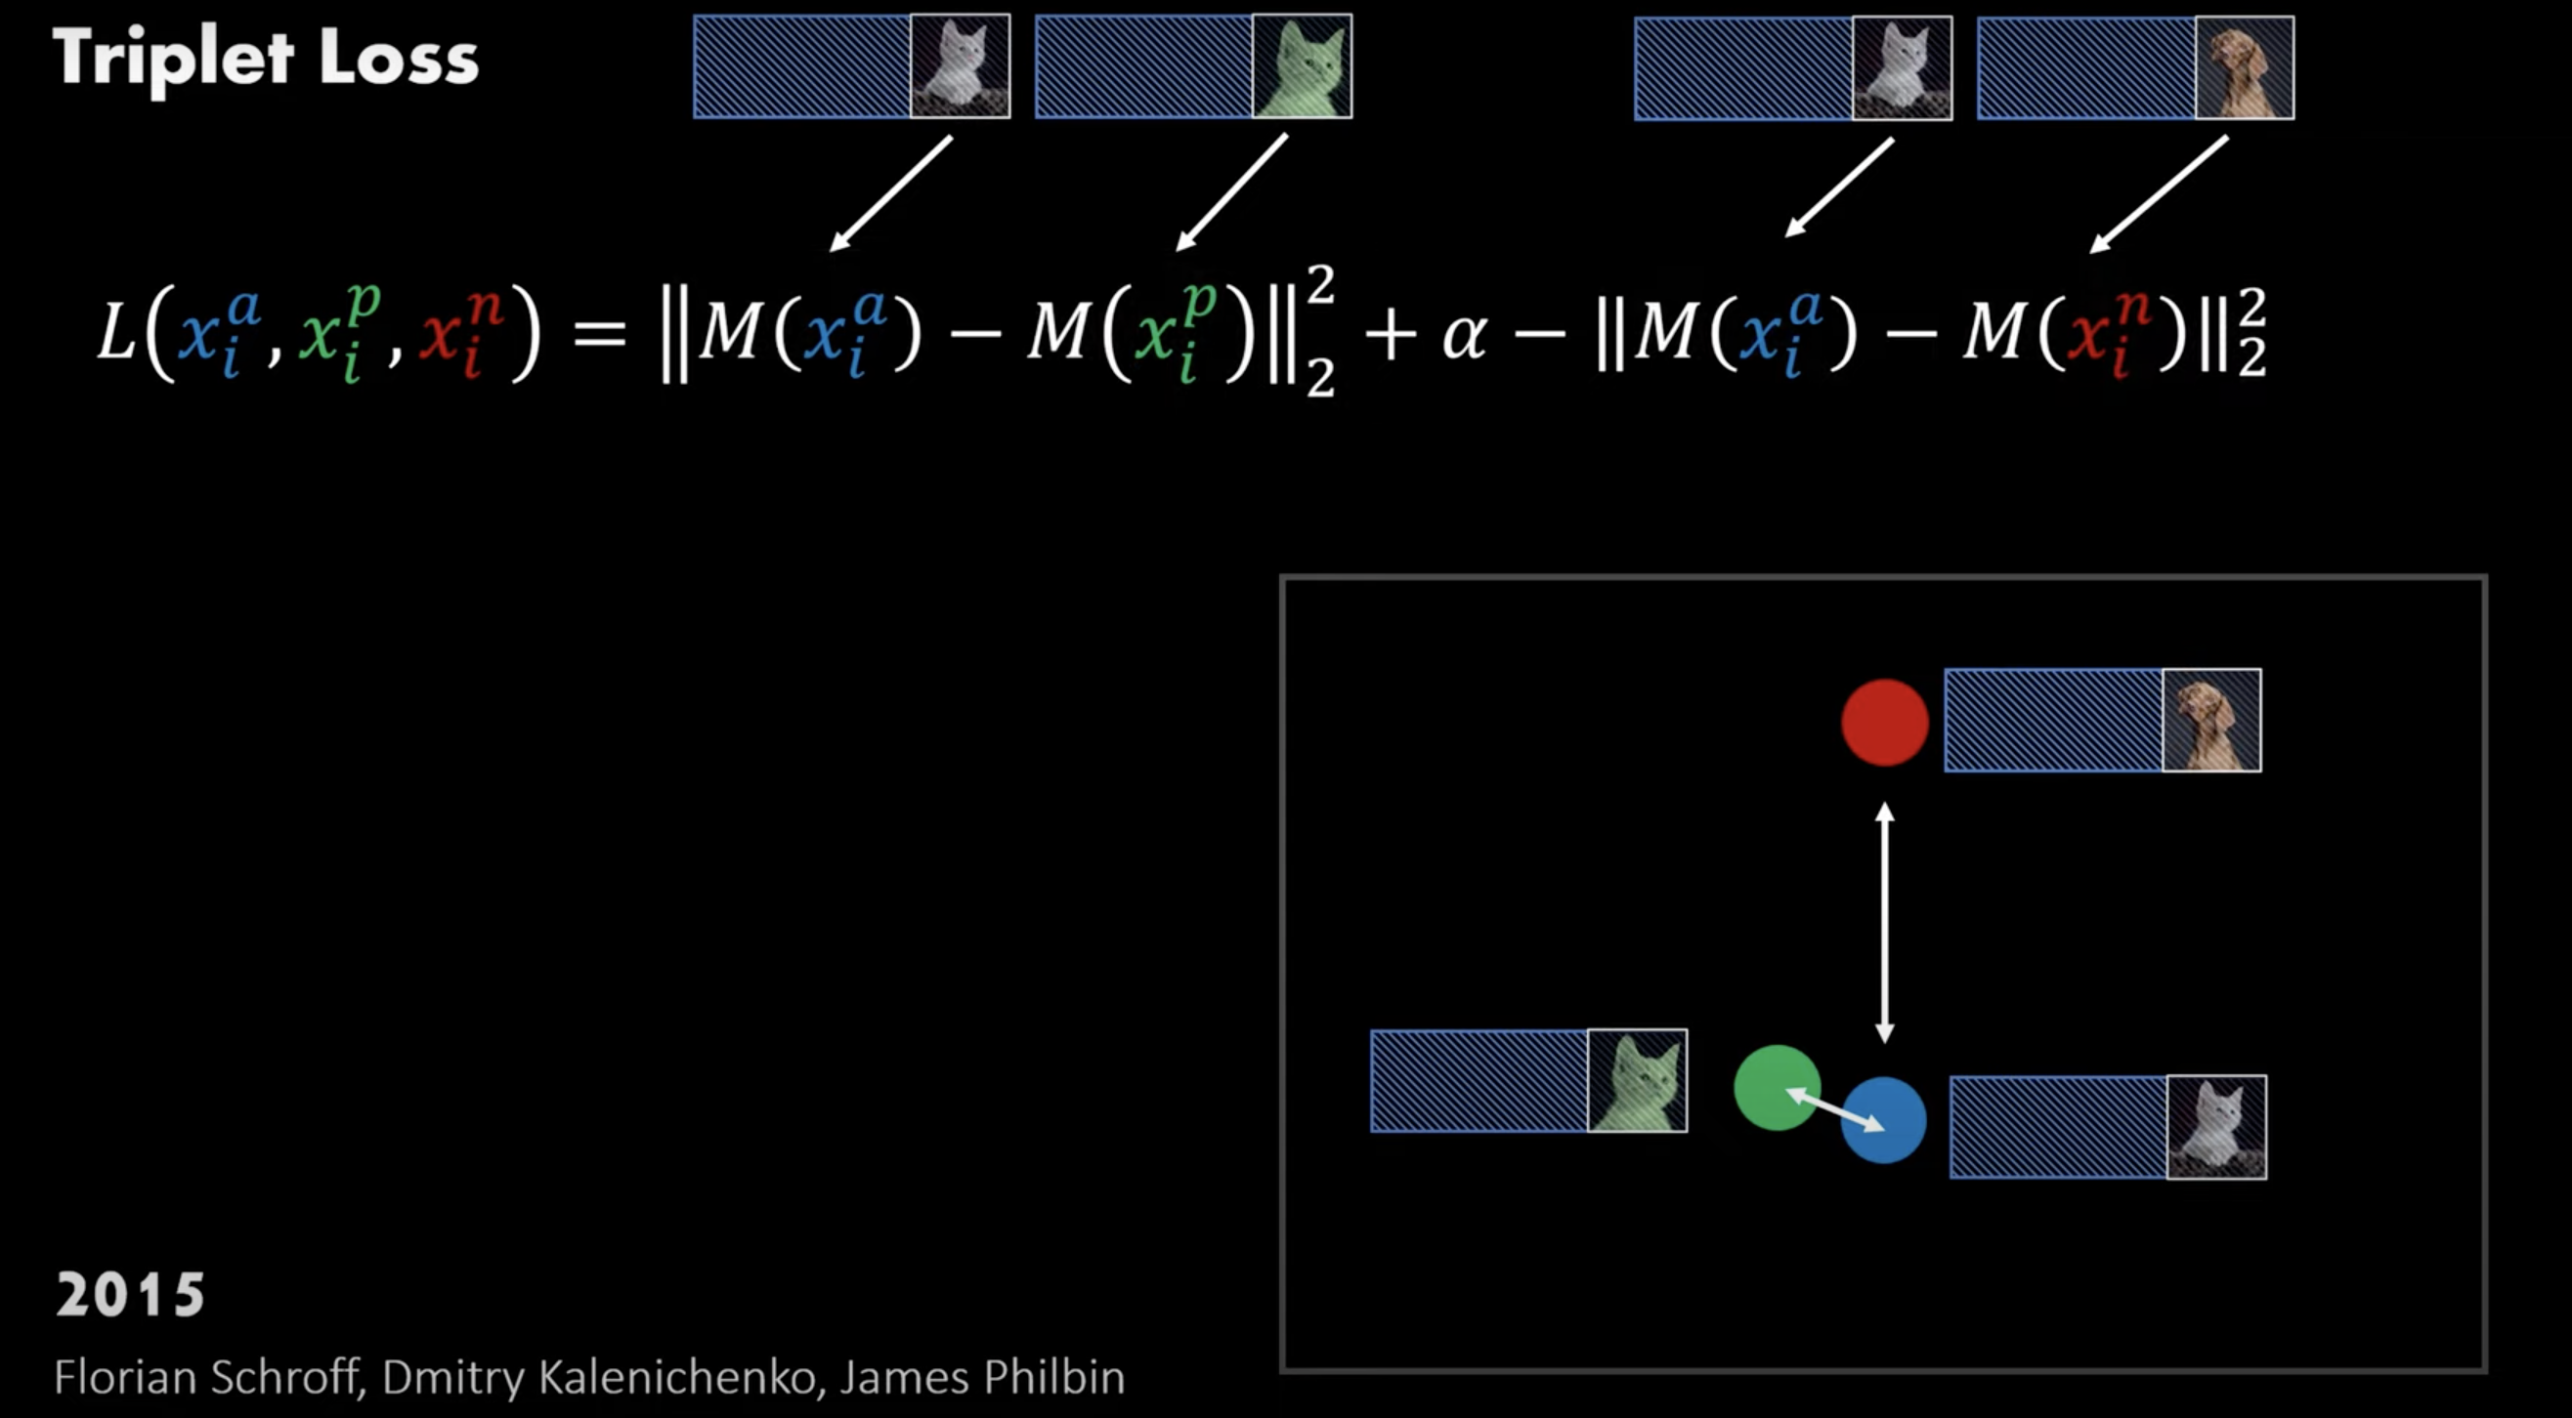
Triplet Loss
https://youtu.be/u-X_nZRsn5M?si=hVAEmak-y7D7yqms

Slide 17
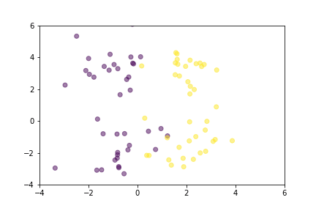
Triplet Loss

Slide 18
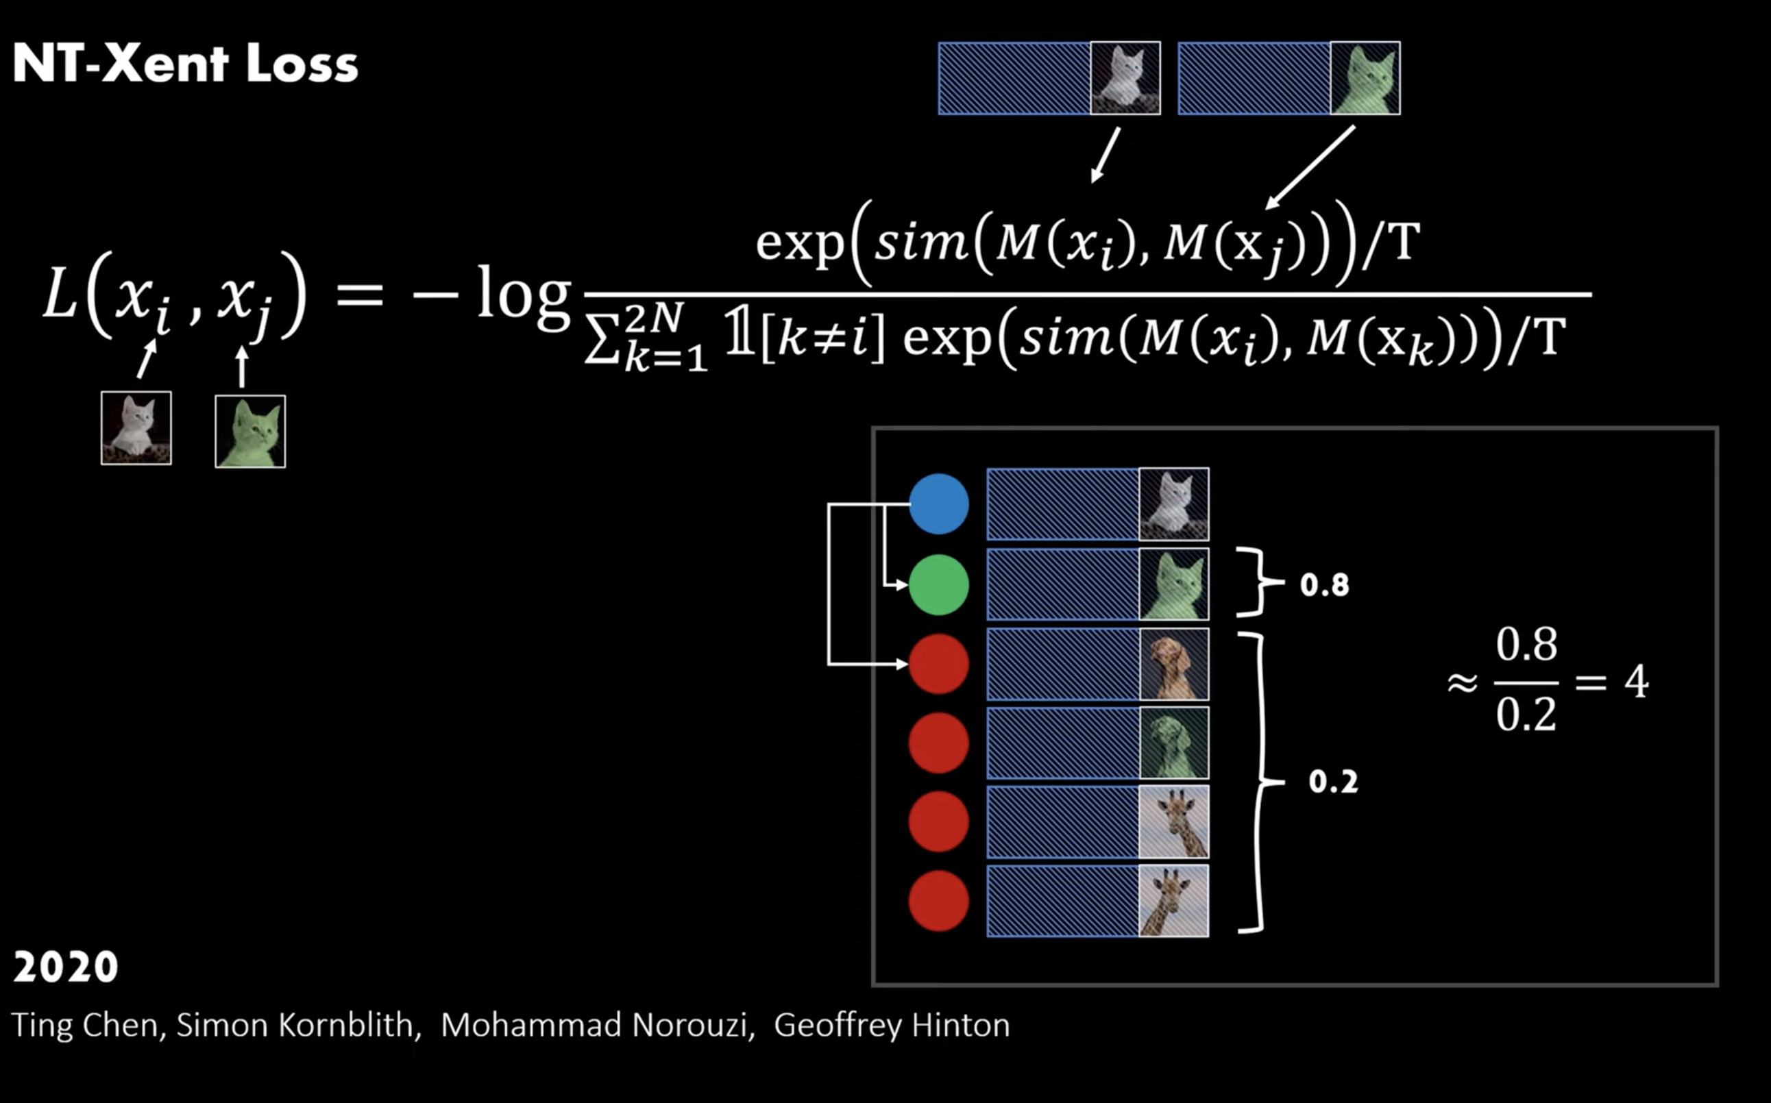
NT-Xent Loss
https://youtu.be/u-X_nZRsn5M?si=hVAEmak-y7D7yqms

Slide 19
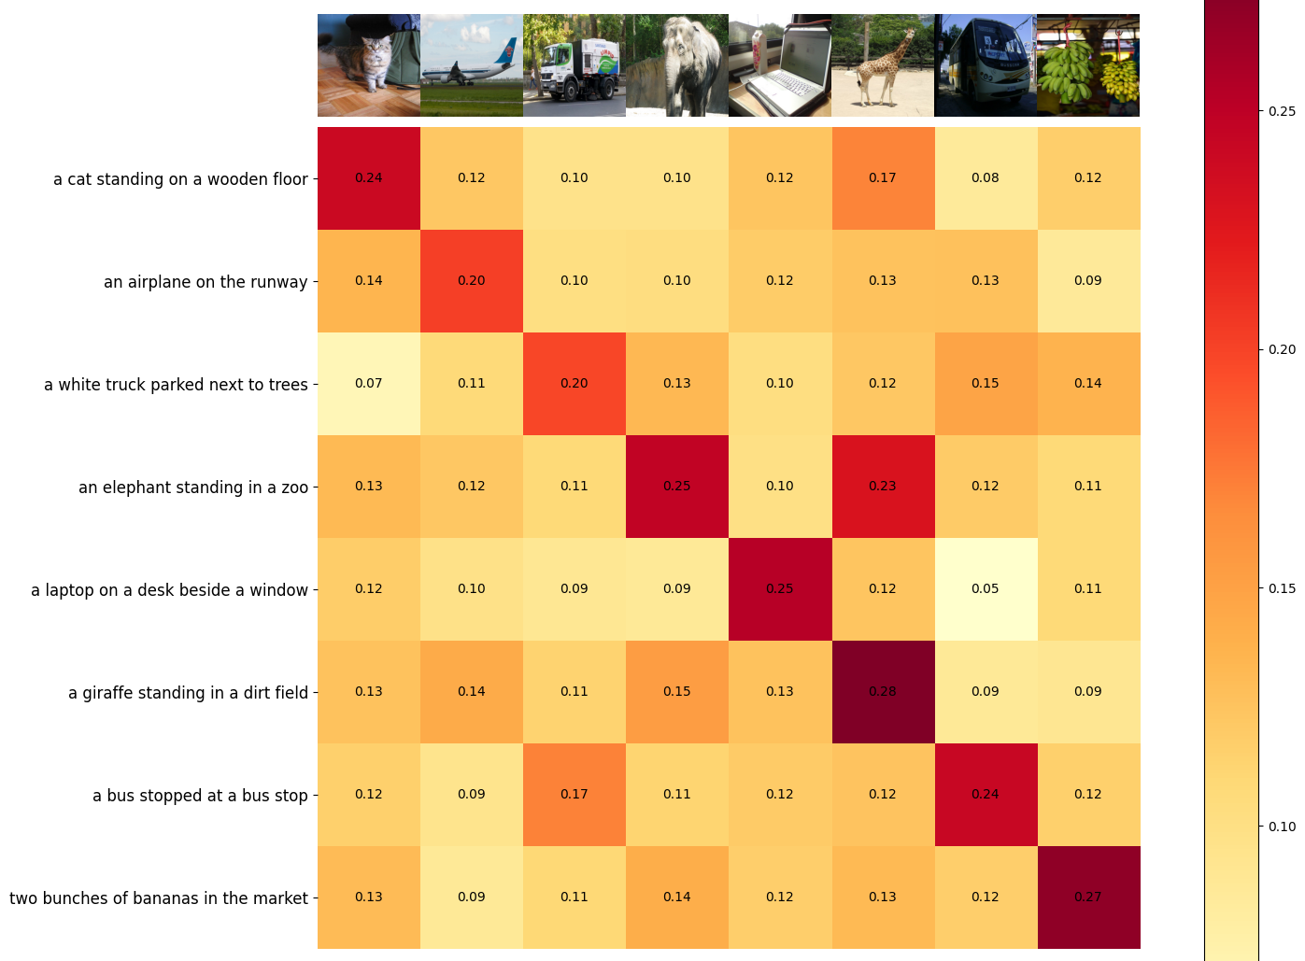
Contrastive Pre-Training

Slide 20
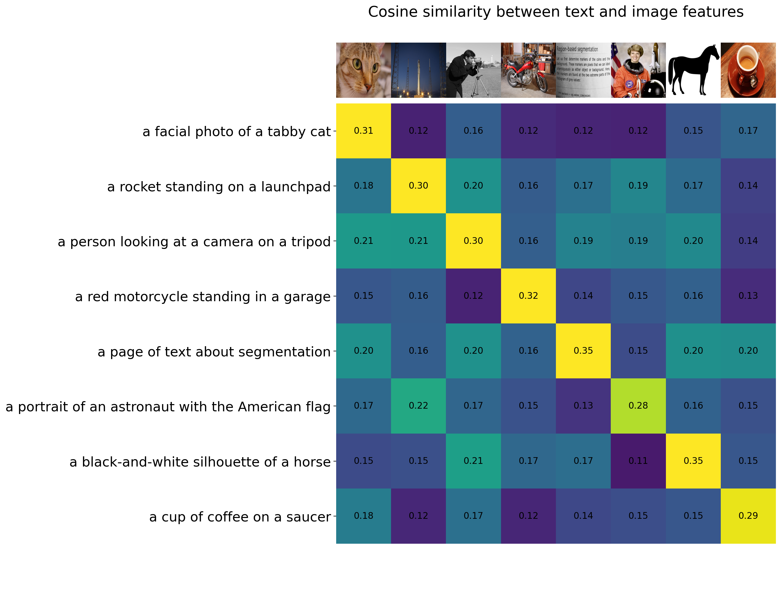
Contrastive Pre-Training

Slide 21
Applications: Zero-Shot Classification
CLIP can classify images into categories that were not included during its training. This is possible because it generates image and text embeddings that are directly comparable, enabling the model to predict categories based solely on textual descriptions provided at runtime.

Slide 22
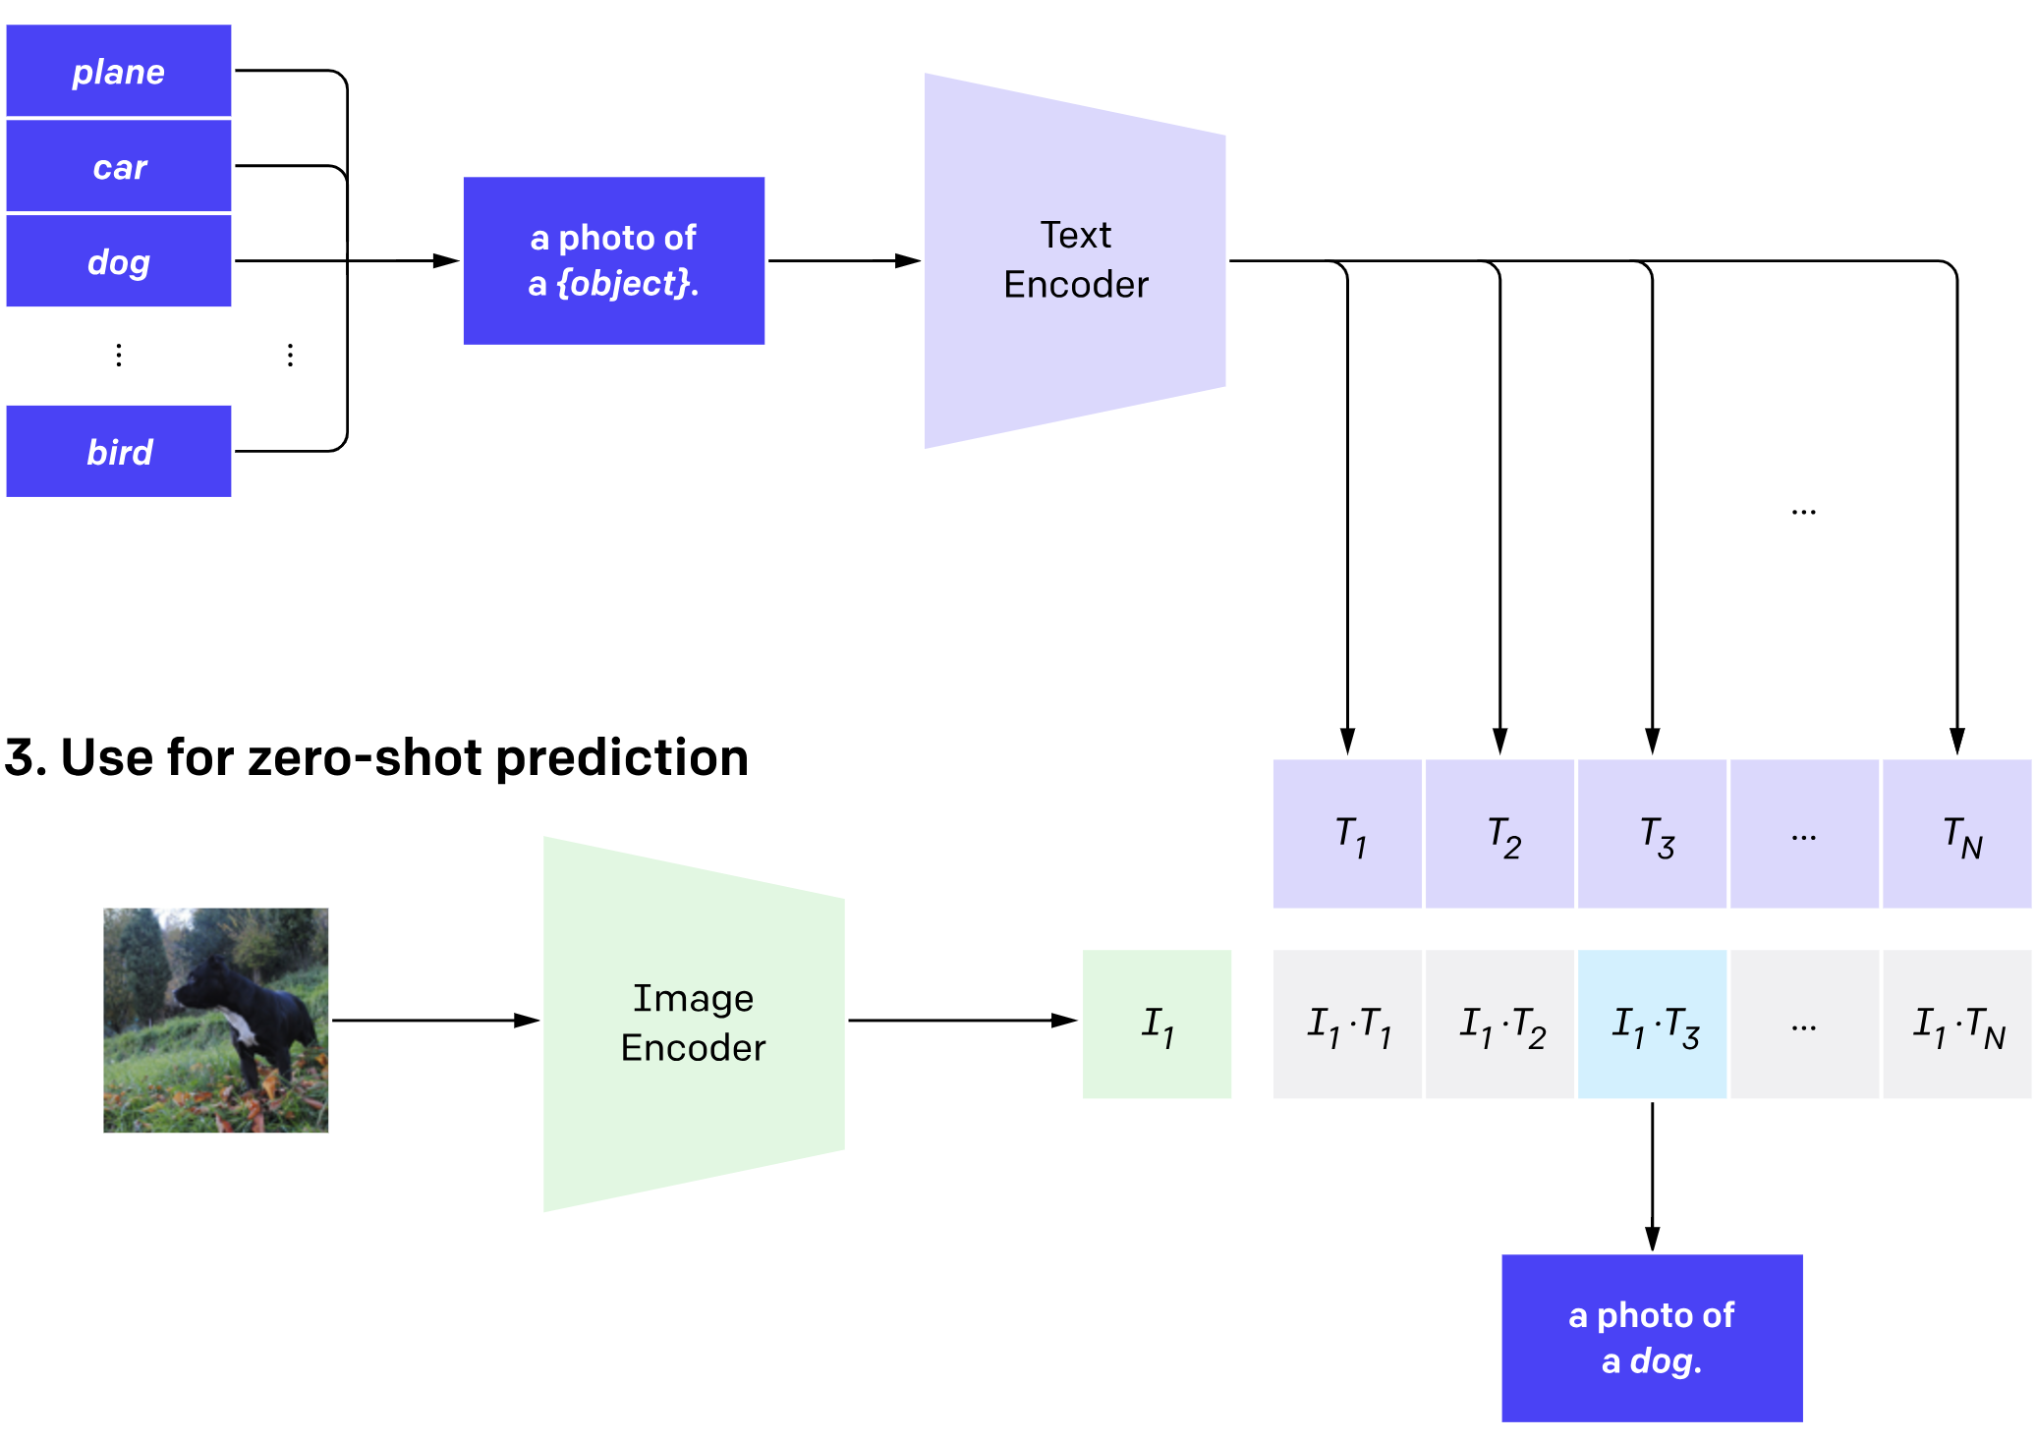
Create Dataset Classifier from label Text
Zero-shot prediction

Slide 23
Create Dataset Classifier from label Text
Zero-shot prediction

Slide 24
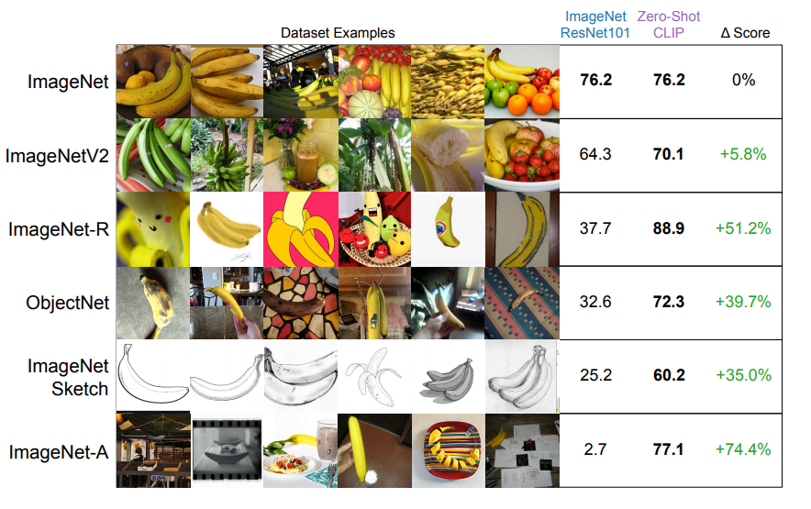
Comparison

Slide 25
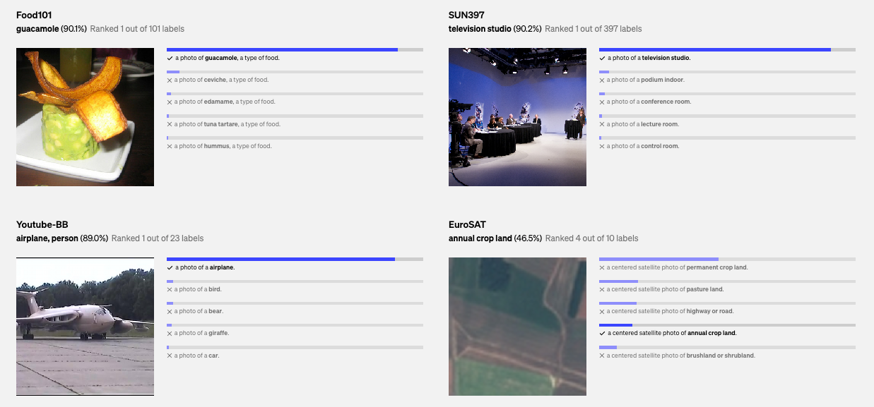
Results

Slide 26
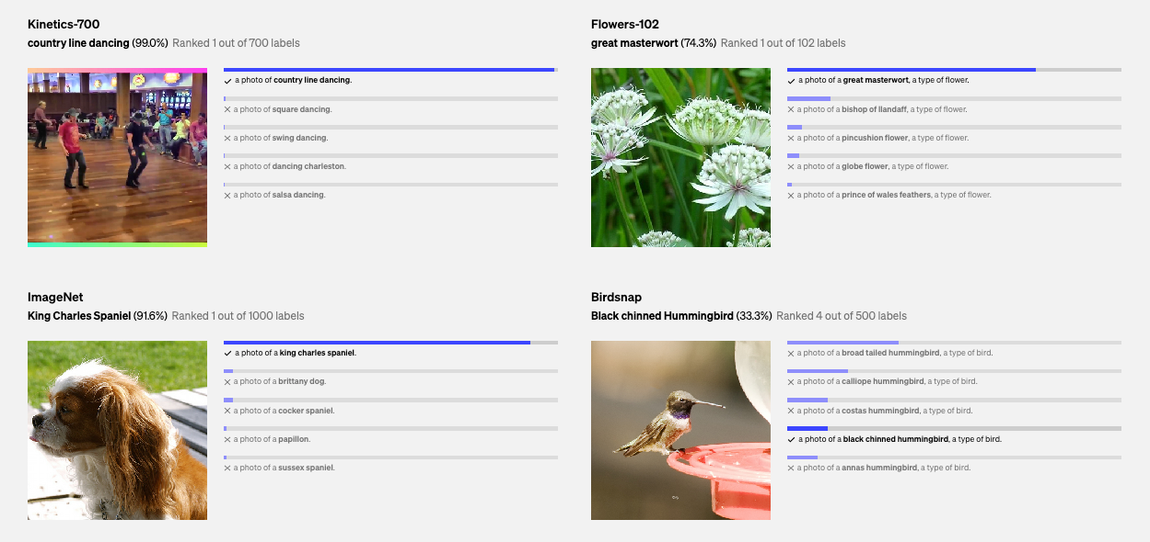
Results

Slide 27
Applications: Image Retrieval
By converting both text queries and images into a common embedding space, CLIP can efficiently retrieve images that are semantically related to textual queries, enhancing search functionalities in databases and online.

Slide 28
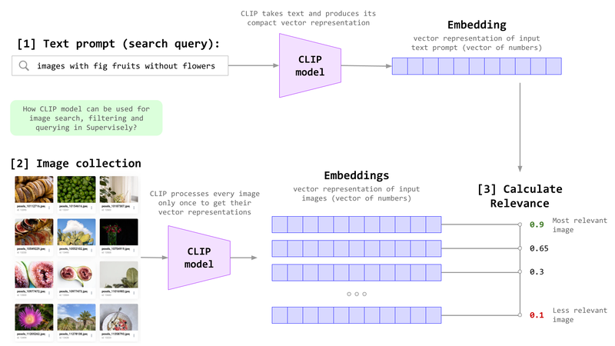
Applications: Image Retrieval

Slide 29
Applications: Image Caption
CLIP can assist in generating descriptive captions for images or even help generate images from textual descriptions by linking the textual content with visual representations.
Two people relax on a bench under a tree, enjoying a serene ocean view.

Slide 30
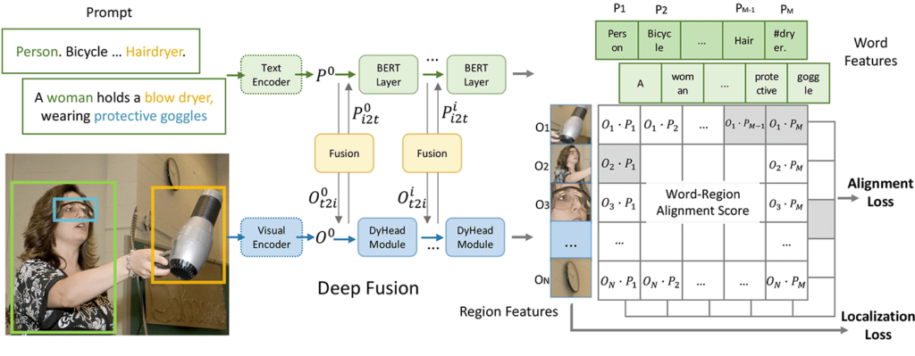
Applications: Object Detection
Although not primarily designed for this, CLIP can be adapted for object detection tasks where objects are detected based on their descriptions rather than traditional bounding box annotations.

Slide 31
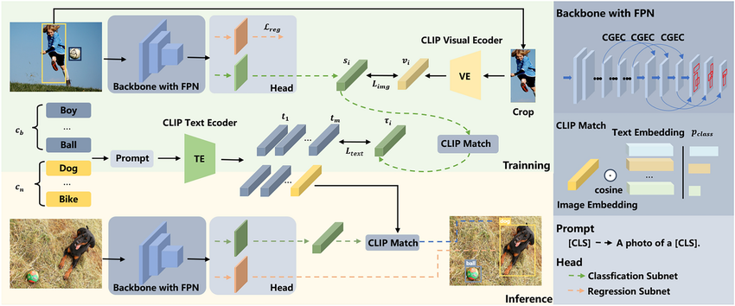
Applications: Object Detection
Although not primarily designed for this, CLIP can be adapted for object detection tasks where objects are detected based on their descriptions rather than traditional bounding box annotations.

